Slide 1
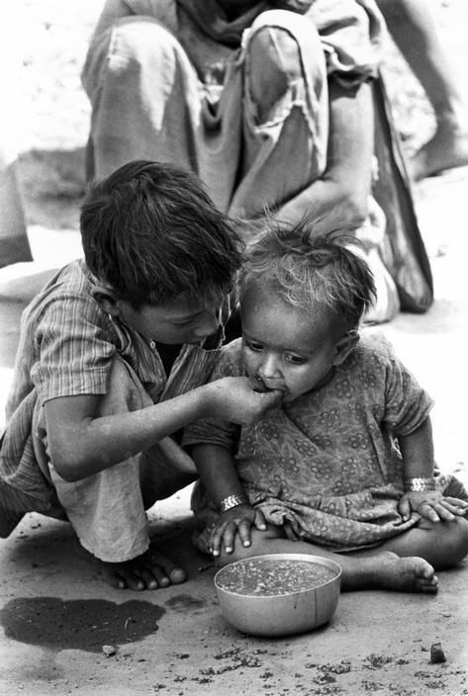
NGO
Management
System

Slide 2
Introduction
This project is based on NGO Management System which is implemented through SQL using MySql Server.
The project includes entities of the donors and receivers and establish relationship between them. Each entity contains Primary Keys and some have foreign key in order to identify relationship between them.
This can help owner to easily update, delete and insert data in the NGO database .

Slide 3
OBJECTIVES
The main Objective of NGO Management System is to provide a friendly environment to maintain the details of donors, charity organizations, poor families, items distributed to them and all the volunteers working with them.
It also manages all the information about the releasing of funds and other items and all the families receiving the items, thus it helps in analysis of supply to regular funds to needy people.
Greater access to accurate information.
Greater accountability and transparency in operations.
The main purpose of this project is to maintain easy circulation system using computers and to provide different reports.

Slide 4
Data Dictionary
NGO management System contains following tables-
Volunteer-students working with NGO.
2.Organization-different charity organizations
3. Donors- sponsors donating funds or items.
4.Poor_families- families receiving the funds or items.
5.Items_donated-number of items given by NGOs to different families.

Slide 5
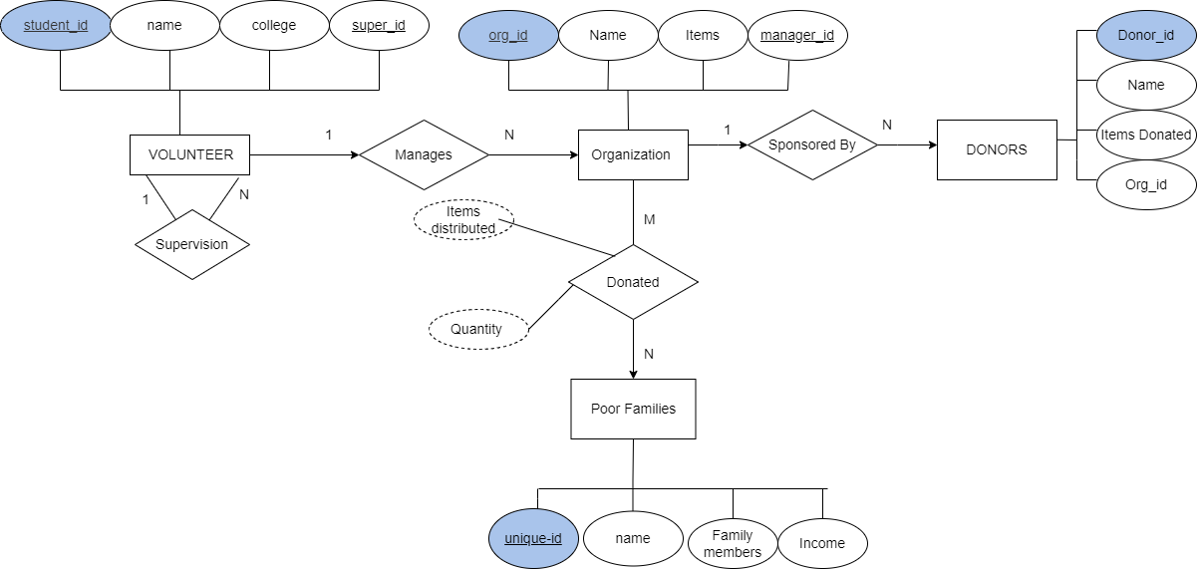
ER Diagram

Slide 6
Student_id | Name | College | Super_id
102 | Kayna | Symbiosis | 102
103 | Priya | IIT-Kanpur | 103
104 | Yash | Punjab University | 103
105 | Kiaan | IIM-Calcutta | 104
106 | Yuvaan | Bits pilani | 105
107 | Tiara | Christ University | 105
create table Volunteer(
student_id INT PRIMARY KEY,
name VARCHAR(20),
college VARCHAR(20),
super_id INT,
)
insert into [Volunteer] values( 102,'Kayna','Symbiosis',102);
insert into Volunteer values( 103, 'Priya',IIT-Kanpur,103);
insert into Volunteer values( 104, 'Yash', 'Punjab University',103);
insert into Volunteer values( 105, 'Kiaan', 'IIM-Calcutta' ,104);
insert into Volunteer values( 106, 'Yuvaan', 'Bits pilani' ,105);
insert into Volunteer values( 107, 'Tiara', 'Christ University',105);

Slide 7
ORGANIZATION
Org_id | Name | items | Manager_id
1 | Myna mahila | Sanitary napkins | 104
2 | Smile Foundation | Stationery items | 102
3 | Snehalaya | Health Kits | 106
4 | Katha | Books | 105
5 | Nanhi kali | Funds | 103
6 | Goonj | Clothes | 107
create table Organization (
org_id INT PRIMARY KEY,
name VARCHAR(20),
items VARCHAR(20),
manager-id INT
)
insert into Organization values (1,'Myna mahila','Sanitary napkins',104);
insert into Organization values (2,'Smile Foundation','Stationery items',102);
insert into Organization values (3,'Snehalaya','Health Kits',106);
insert into Organization values (4,'Katha','Books',105);
insert into Organization values (5,'Nanhi kali','Funds',104);
insert into Organization values(6,'Goonj','Clothes',107);

Slide 8
POOR_FAMILIES
Unique_id | Name | Family Members | Income
300 | Das | 5 | 7000
301 | Bedi | 7 | 5000
302 | Jha | 7 | 7000
303 | Basu | 8 | 6000
304 | Kumar | 6 | 4000
305 | Yadav | 4 | 3000
create table poor_families(
unique_id INT PRIMARY KEY,
name VARCHAR(20),
family_members INT
income money
)
insert into poor_families values(300,'Das',5,7000);
insert into poor_families values(301,'Bedi',7,5000);
insert into poor_families values(302,'Jha',7,7000);
insert into poor_families values(303,'Basu',8,6000);
insert into poor_families values(304,'Kumar',6,4000);
insert into poor_families values(305,'Yadav',4,3000);

Slide 9
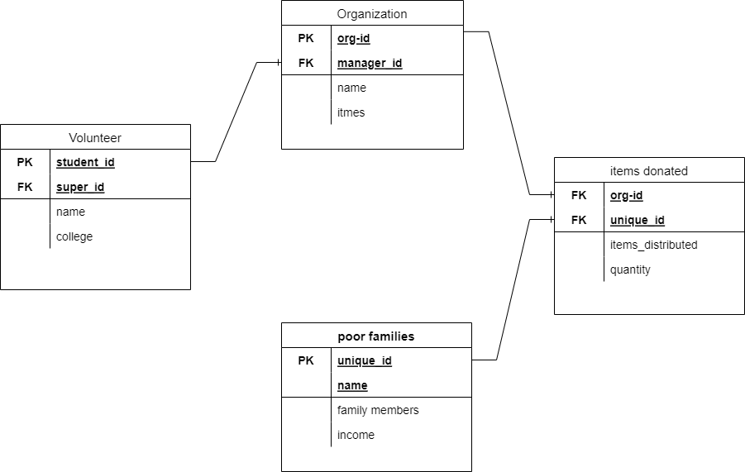
Database Diagram

